Slide 1
Thanks a lot!
Basic 01 Unit 3a

Slide 2
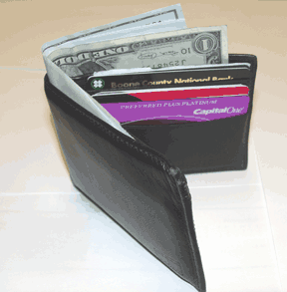
What is this called in English?
It is a wallet.

Slide 3
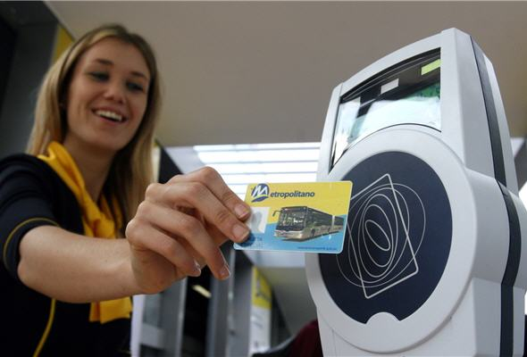
What is this called in English?
It is a bus pass.

Slide 4
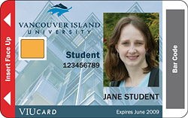
What is this called in English?
It is a student ID card.

Slide 5
Create short conversations exchanging gifts with your classmates. First introduce yourself and then continue with the conversation
Hi, I´m Jose, What´s your name?
Hello Jose, I am ________ .
.
Jose, this is for you.
Oh, let´s see……What´s this?
Wow, an iPod touch !
*Thank you so much. It is beautiful.
or *Thanks. I like it a lot. It is…..
or *Thanks. I like them a lot. They are …..
Sure, Jose. I´m glad you like it. ☺

Slide 6
A: What did you get?
B: I got an MP4 from Lucia, a book from Gina, sunglasses from April, and a gift card from Luz.
A: Which is your favorite?
B: My favorite is the ________

